Slide 1
FoodieBuddie
G10T6
Terence Neo
Christal Poon
Gracia Yuwono Kwantalalu
Kok Jim Meng

Slide 2
Contents
Background and Business Problem
Overview of Methodology
Data Collection
Feature Engineering
Data Analysis
Limitations
Possible Extension
The Team and Responsibilities

Slide 3
Why Food
Singapore, the Food Paradise
S$8.3b S$4.3b 48k
annual receipts annual contribution to GDP workers employed
Increasing demand due to growing urban population & middle class
Planned by 2020 (Source: MTI’s Food Industry Transformation Map)
4.5% 2,000
productivity growth new jobs

Slide 4
Business Problem
Objectives
Help new and existing food businesses maximise their share of this billion dollar industry with tailored food offerings
Recommend upcoming trends, based on derived insights from social media analyses
Recommend potentially popular food items/ food groups to maximise profits
Identify potential food influencers to work with to maximise reach & exposure
Notes:
See influencers’ post (30 may-30 june) -> gain insights into what food they’re promoting. Being influencers, they are the best ppl we can learn from to predict upcoming trend -> give the insight of trending food to entrepreneurs to give them an idea of what to sell/what to incorporate into their menu

Slide 5
Overview
INSTAGRAM
PYTHON
- Beautiful soup
- Selenium
PANDAS
WORDCLOUD
TABLEAU
GEPHI
source
tools
Data preprocessing
Save data into dataframe
Identify the top 5 food -> generate corpus
Data Visualisation
Social network graph
Scrape influencers’ posts (1 month)

Slide 6
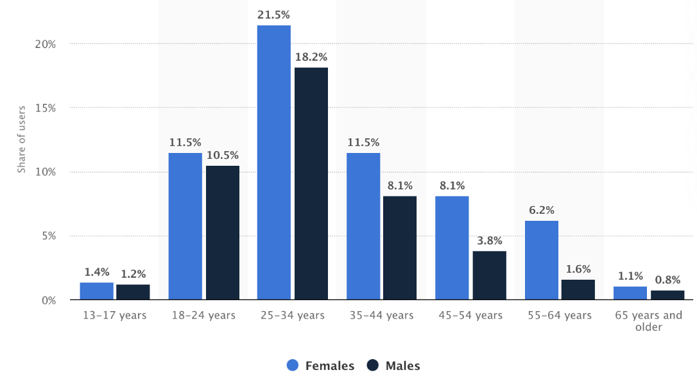
Why Instagram
2.3M / 5.7M 59.3%
Singapore users are working class (25-44)
(Source: Statista, and MediaOne)

Slide 7
Data Collection
Scrape Instagram posts of 12 food influencers within 1 month (30 May-30 June)
1. danielfooddiary (239k)
2. misstamchiak (154k)
3. ieatishootipost (136k)
4. sethluicious (114k)
5. foodkingnoc (109k)
6. eatbooksg (75.7k)
7. stormscape (73.6k)
8. 8days_eat (64.8k)
9. hungrygowhere (62.7k)
10. burpple (61.4k)
11. sgfoodonfoot (54.9k)
12. sheeatsshecooks(53.6k)
13. fundamentally_flawed (46.6k)
14. thesilverchef (46.5k)
Select 12 most relevant influencers

Slide 8
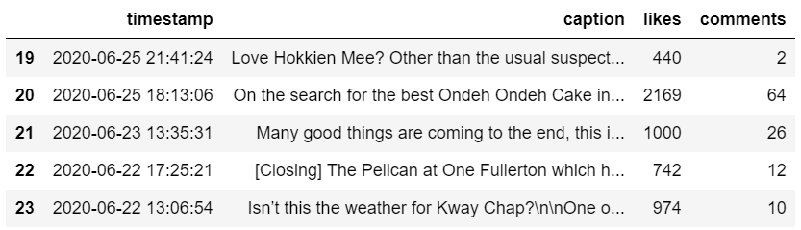
Data Collection
Scrape Instagram posts of 12 food influencers
1 month (30 May-30 June)
Example scrape:

Slide 9
Feature Engineering - WordCloud and One-Hot Encoding
Extracting features from our raw data via data mining techniques
The techniques include:
WordCloud to create corpus of food items to search for
One-hot encoding the chosen corpus on each post caption by creating new columns to contain labels

Slide 10
Data Analysis
WORD FREQUENCY
ANALYSIS
2. SOCIAL NETWORK ANALYSIS

Slide 11
1.1. WORD FREQUENCY ANALYSIS
IDENTIFY TOP FOOD
Tools and Packages
Pandas
Tableau
Charts
Likes for each food in corpus
Comments for each food in corpus
Number of posts for each food in corpus
Possible Insight
Food most posted about may not be the food with the most likes

Slide 12
1.2. WORD FREQUENCY ANALYSIS
IDENTIFY TOP INFLUENCERS
Tools and Packages
Pandas
Tableau
Charts
Likes for each influencer
Comments for each influencer
Number of posts for each influencer
Possible Insight
The most active influencers may not have the most active user interactions

Slide 13
2. SOCIAL NETWORK ANALYSIS
Tools and Packages
GEPHI
Approach
Network graph
12 Influencers and users as nodes
Interactions (comments) as edges
Coloured by influencer
Possible Insight
Determine reach and exposure of influencers

Slide 14
Non-Technical Limitations
Recommendations may not be feasible to eateries that are not flexible in changing their cuisines / menus
Not all Singaporean food bloggers use Instagram as they have their own personal websites and blogs
Some food bloggers repost other people’s food posts on Instagram

Slide 15
Technical Limitations
Same food phrased in different ways (eg. roti-prata, roti prata, muturbak)
Presence of fake accounts / multiple accounts per person on Instagram may inflate numbers
Unable to track sharing on other platforms
Metric may not reflect sentiment - users may react or comment with negative sentiments

Slide 16
Extension: Data Analysis
3. SENTIMENT
ANALYSIS

Slide 17
3. SENTIMENT ANALYSIS
More accurate metric
Approach
Create sentiment score for each comment in each post (range -1 to +1)
Sentiment score each post = sum(scores for comments)
Plot ranking charts in Tableau for food and influencers
Possible Insights
Most reactions/ post activity may not result in the most positive sentiments
Notes:
Likes and comments are summed across all post for each food

Slide 18
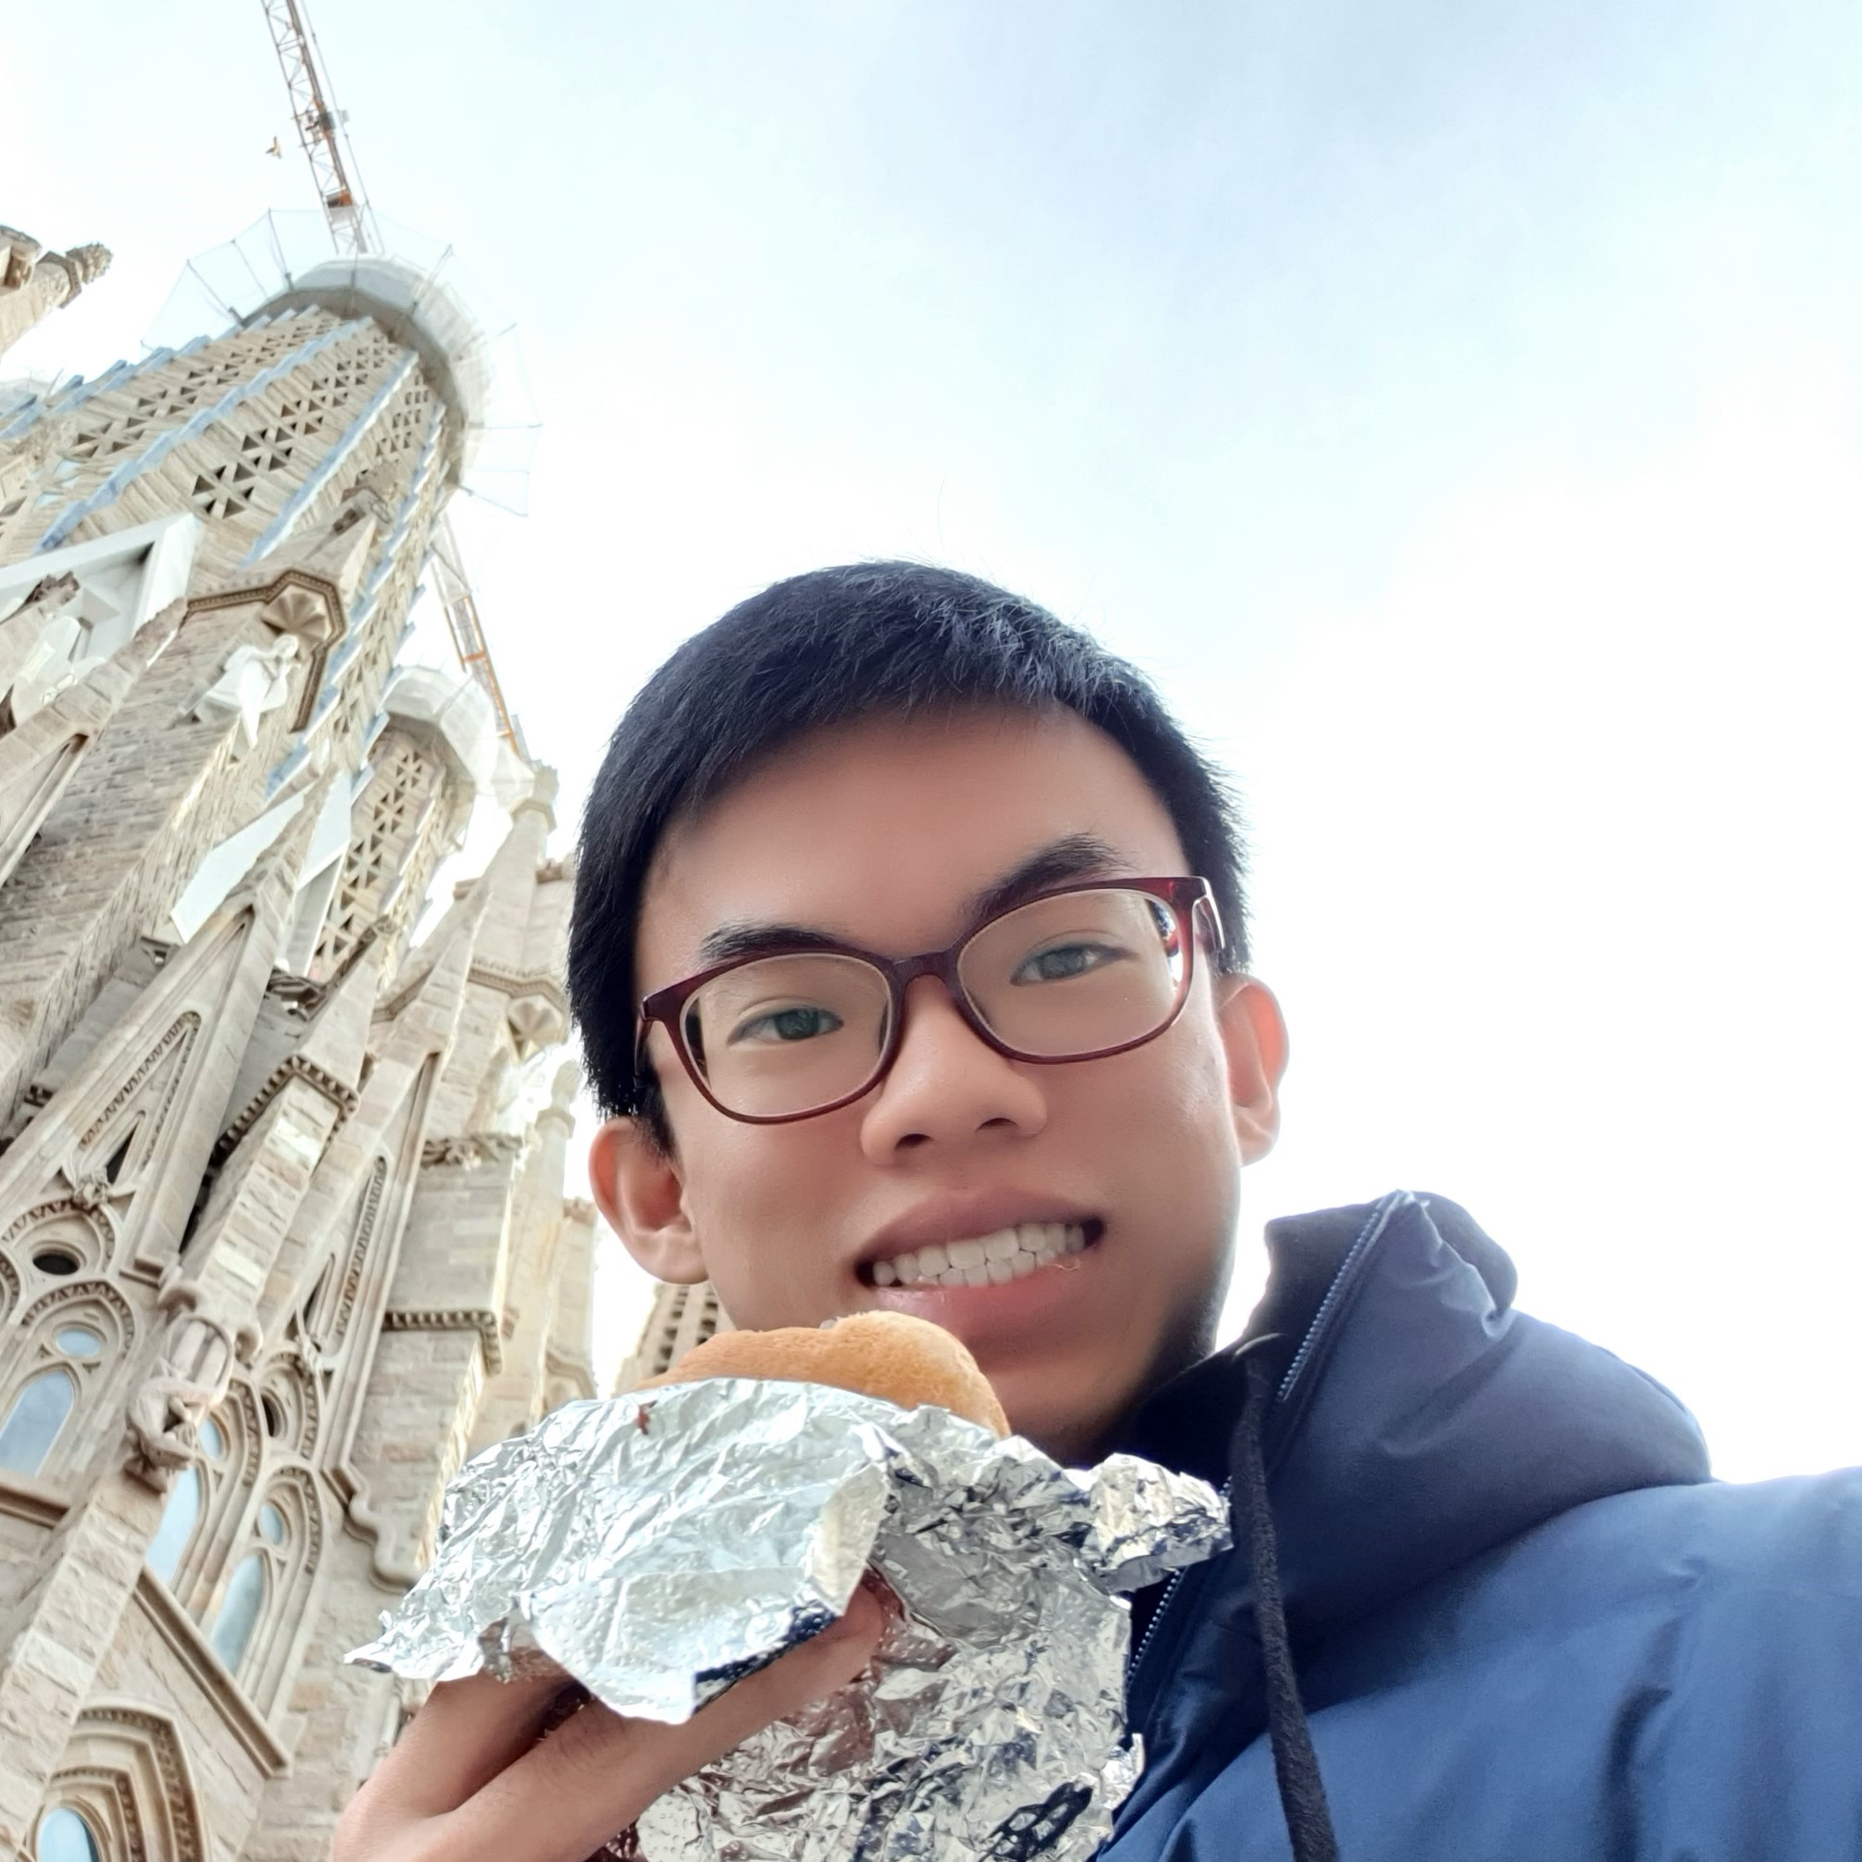
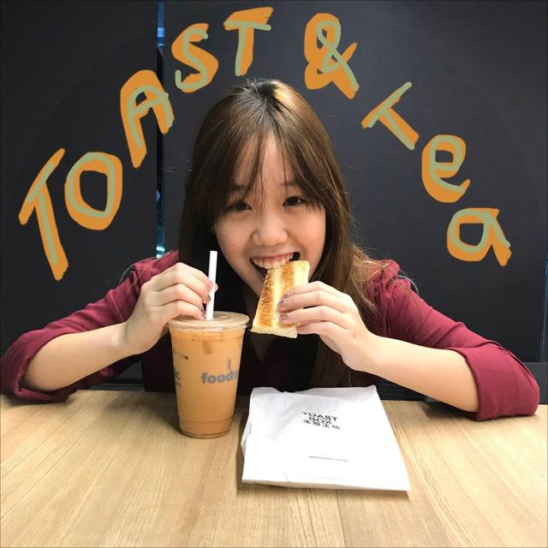
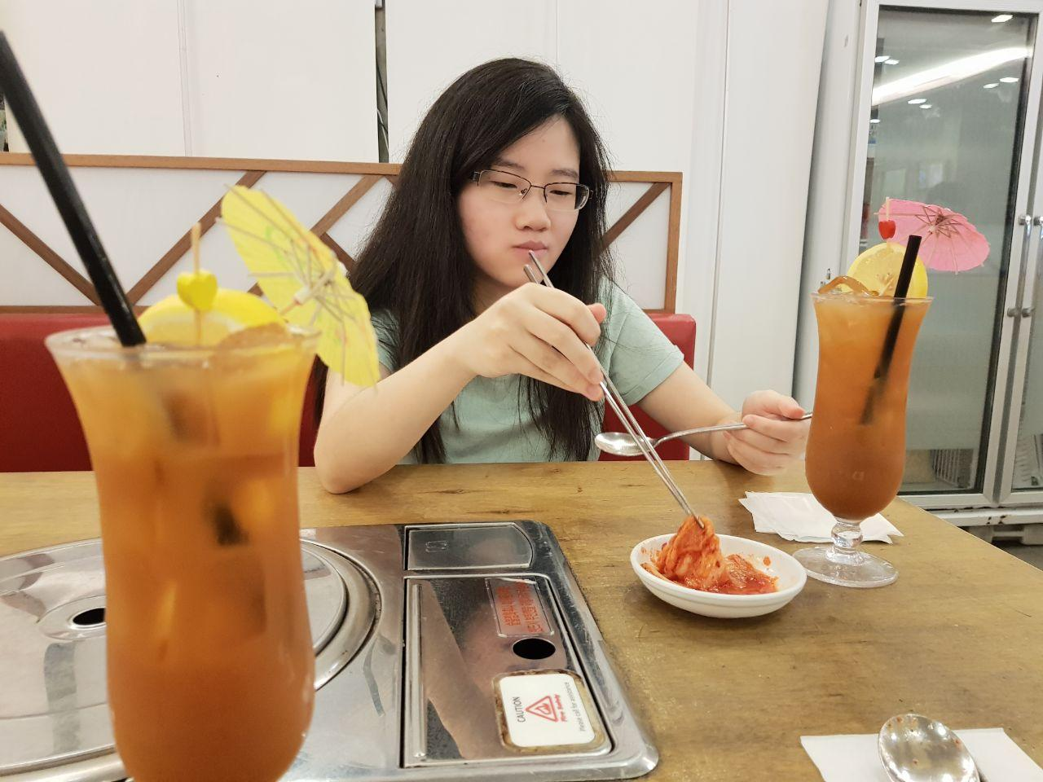
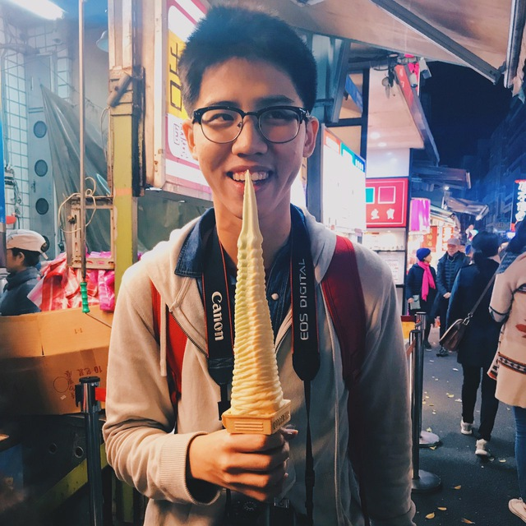
The Team
Terence
Christal
Gracia
Jim Meng
Role
Data Analyst
Data Visualisation
Generate report and slides
Role
Business Gathering
Digital Designer
Generate report and slides
Role
Data Scraper
Data Visualisation
Generate report and slides
Role
Project Scheduler
Data Cleaning
Generate report and slides
Notes:
Some possible roles you can pick from
Data Compiling
Data Cleaning
Data Crawler
Data Analyst
Data Visualization
Report Writing
Report Compiling
business gathering
report writer, web scraping programmer, data analysis programmer

Slide 19
THANK YOU
Feel free to ask us any questions or to give us suggestions

